Slide 1
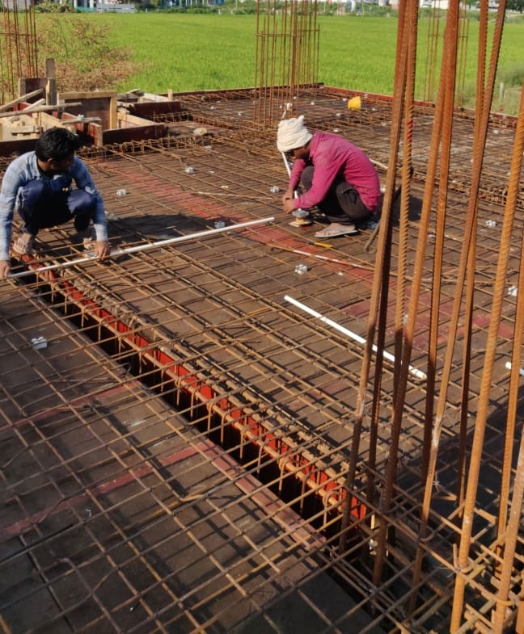
Tower-F, GF Slab Electrical Work Up coming Task: Slab Casting will be on 17/10/2019
14-10-2019
Status

Slide 2
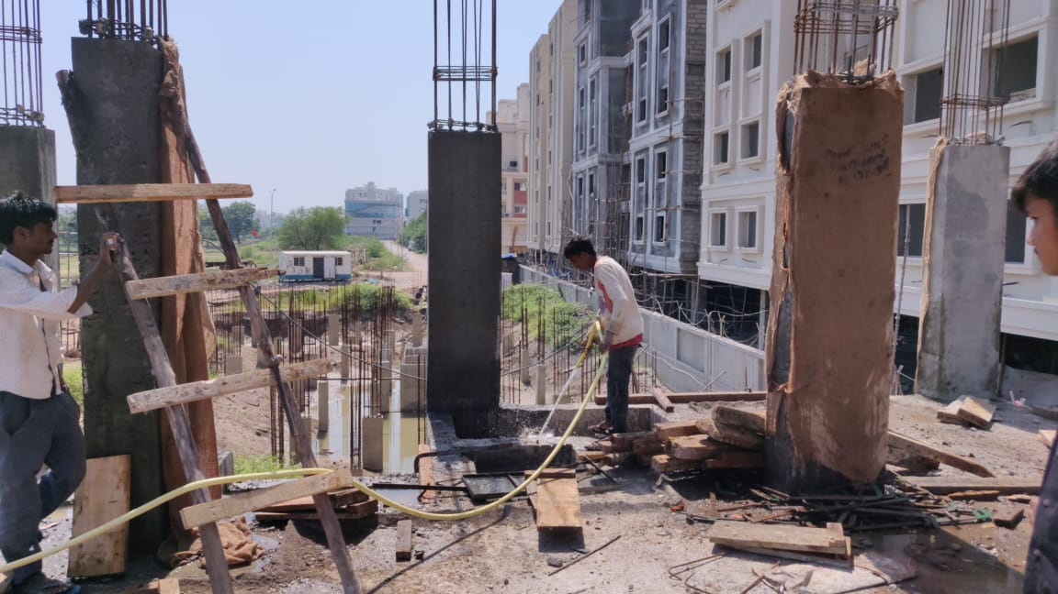
14-10-2019
Status
Tower-E Column Curing Up coming Task: Slab Casting will be on 17/10/2019

